Slide 1

LSTM for Bioinformatics
Presenter: Houwang Zhang
Supervisor: Yuan Zhu
E-mail: zhanghw@cug.edu.cn
School of Automation, China University of Geosciences, Wuhan
Institution of Advanced Control and Intelligent Automation

Slide 2
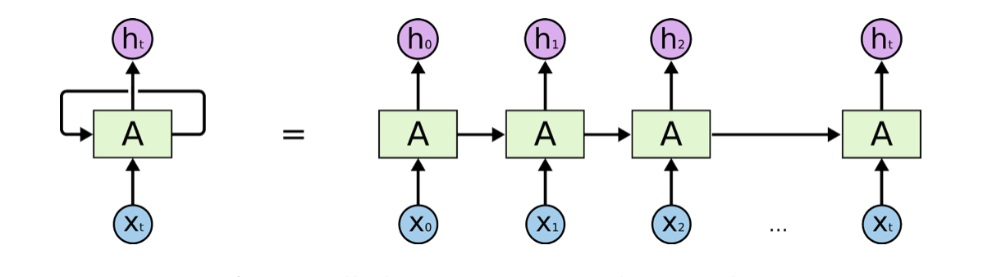
A brief intro for LSTM
Background
循环神经网络（Recurrent Neural Network，RNN）是一种用于处理序列数据的神经网络。相比一般的神经网络来说，能够处理序列变化的数据。
图1. RNN
长短期记忆（Long short-term memory, LSTM）是一种特殊的RNN，主要是为了解决长序列训练过程中的梯度消失和梯度爆炸问题。简单来说，就是相比普通的RNN，LSTM能够在更长的序列中有更好的表现。
Institution of Advanced Control and Intelligent Automation

Slide 3
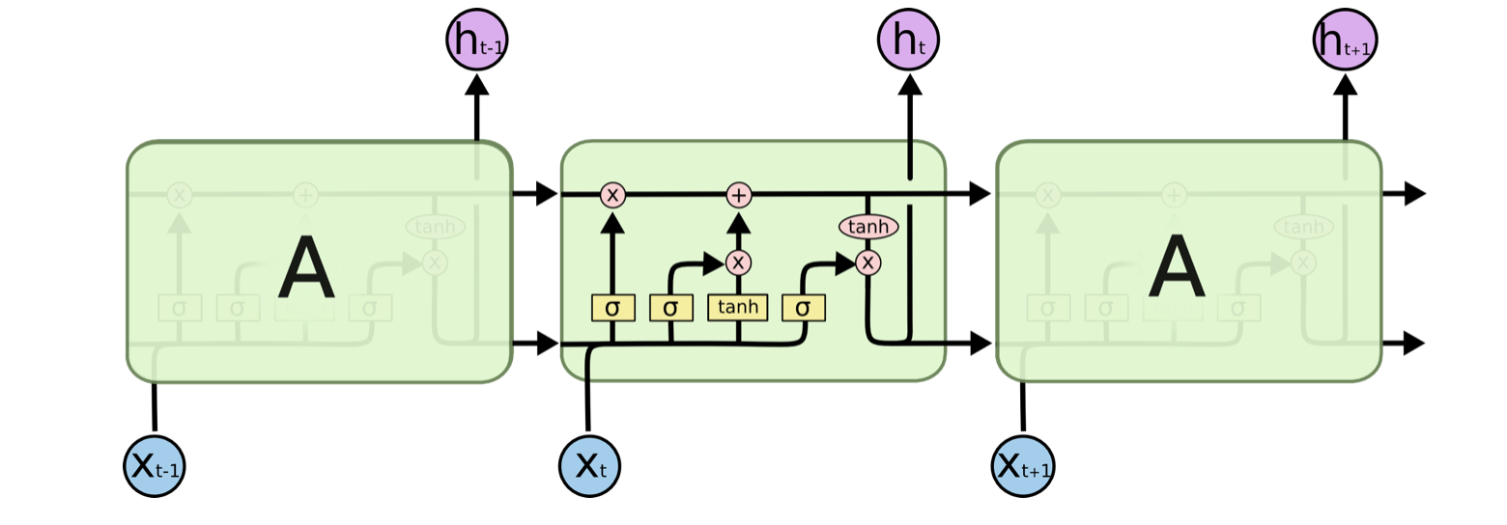
A brief intro for LSTM
Background
LSTM的内部结构。通过门控状态来控制传输状态，记住需要长时间记忆的，忘记不重要的信息；而不像普通的RNN那样只能够“呆萌”地仅有一种记忆叠加方式。对很多需要“长期记忆”(例如较长序列)的任务来说，尤其好用。
图2. LSTM
Institution of Advanced Control and Intelligent Automation

Slide 4
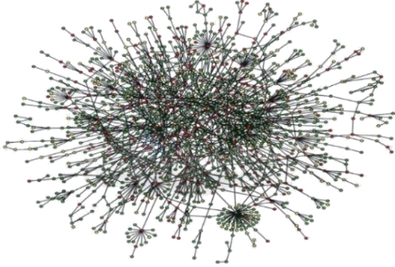
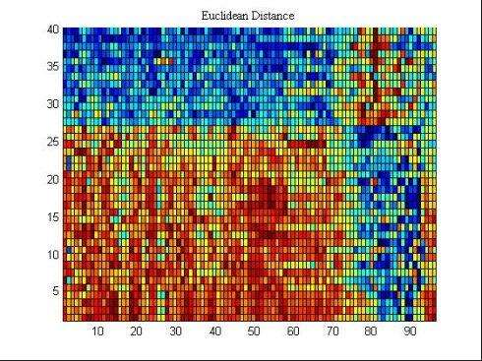
LSTM for Identification of Essential Proteins
Motivation
关键蛋白质的识别属于一个比较经典的生物信息学问题。早期的研究手段主要通过研究蛋白质网络 (PPI) 的拓扑特征以识别关键蛋白质。然而由于蛋白质网络测序的高噪声，PPI 网络大多伴连接缺失或错误连接。
近年来的研究趋势则是通过在识别过程中增加生物信息并结合网络拓扑特征提高识别精度。而大部分生物信息都属于序列信息，例如最常用的基因表达序列则是时空序列。大部分研究方法对生物信息的处理提供采用计算相似性、降维等方法提取特征并用于关键蛋白质的识别，然而这些方法未能充分利用序列数据的信息（如时空特征等），因此我们考虑采用序列模型对关键蛋白质的识别进行研究。
图3. PPI网络及基因表达序列
Institution of Advanced Control and Intelligent Automation

Slide 5
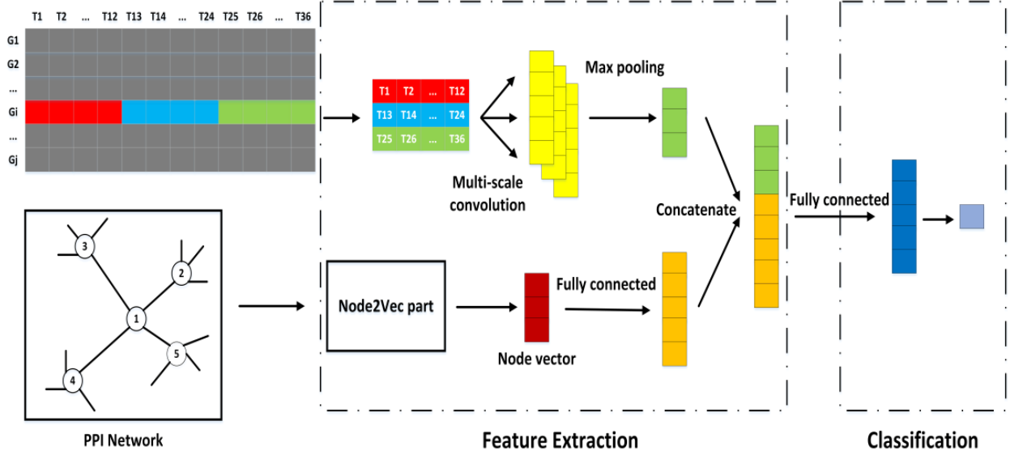
LSTM for Identification of Essential Proteins
Our method
我们借鉴李敏老师的思想，通过 Node2vec 算法提取网络拓扑结构特征并与基因表达数据结合用于关键蛋白质的识别，只是这里我们对所有数据采用序列模型进行处理。
图4. 李敏老师的网络结构
Institution of Advanced Control and Intelligent Automation

Slide 6
LSTM for Identification of Essential Proteins
Our method
Feature Dimension
Label
Time step
Softmax
layer
LSTM layer
Fully connected
layer
LSTM layer
Dropout
Feature Extraction
Classification
图5. An overview of our proposed deep learning framework for identifying essential proteins.
Institution of Advanced Control and Intelligent Automation

Slide 7
LSTM for Identification of Essential Proteins
Experiment Results (compared with machine learning methods)
Models | Accuracy | Precision | Recall | F-measure | AUC
SVM | 0.7053 | 0.2580 | 0.1777 | 0.2105 | 0.5163
Decision Tree | 0.64047 | 0.1894 | 0.1911 | 0.1902 | 0.4795
Adaboost | 0.6748 | 0.2087 | 0.1688 | 0.1867 | 0.4936
Random Forest | 0.6650 | 0.21 | 0.1866 | 0.1976 | 0.4937
Li et.al | 0.7507 | 0.4186 | 0.2317 | 0.2983 | 0.5681
Our method | 0.71638 | 0.3402 | 0.3933 | 0.3648 | 0.5971
Institution of Advanced Control and Intelligent Automation

Slide 8
LSTM for Identification of Essential Proteins
Experiment Results (compared with traditional methods)
Models | Accuracy | Precision | Recall | F-measure | AUC
DC | 0.7329 | 0.4052 | 0.3538 | 0.3778 | 0.5997
CC | 0.7137 | 0.3572 | 0.3119 | 0.333 | 0.5725
BC | 0.7125 | 0.3542 | 0.3093 | 0.3302 | 0.5708
EC | 0.7188 | 0.3699 | 0.3230 | 0.3449 | 0.5797
LAC | 0.7565 | 0.4641 | 0.4053 | 0.4327 | 0.6331
Our method | 0.71638 | 0.3402 | 0.3933 | 0.3648 | 0.5971
Institution of Advanced Control and Intelligent Automation

Slide 9
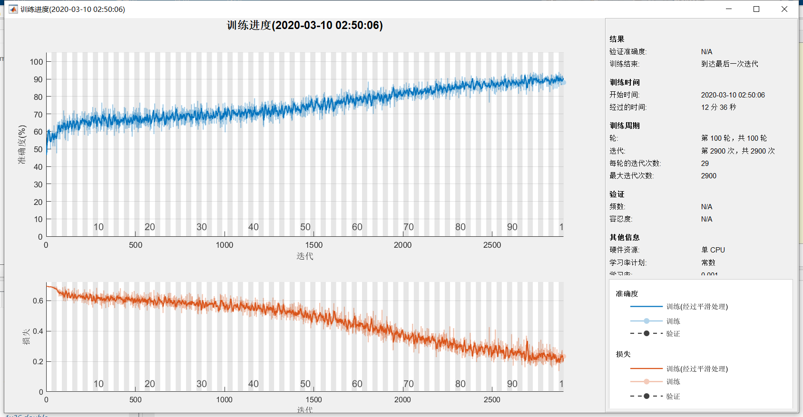
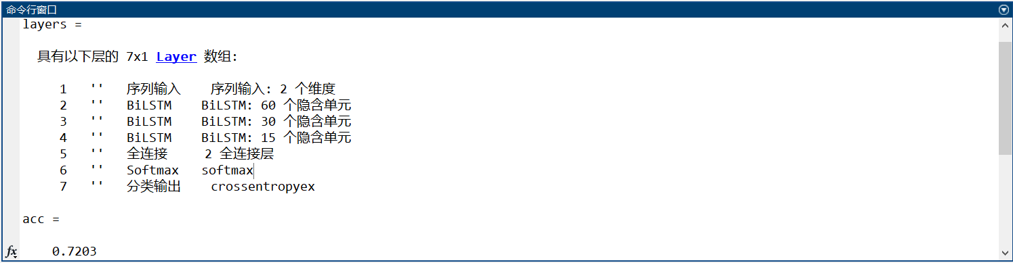
LSTM for Identification of Essential Proteins
Training Process
Institution of Advanced Control and Intelligent Automation

Slide 10
LSTM for Identification of Essential Proteins
Prepared to do
Try new dataset
New model (like graph deep learning)
Institution of Advanced Control and Intelligent Automation

Slide 11
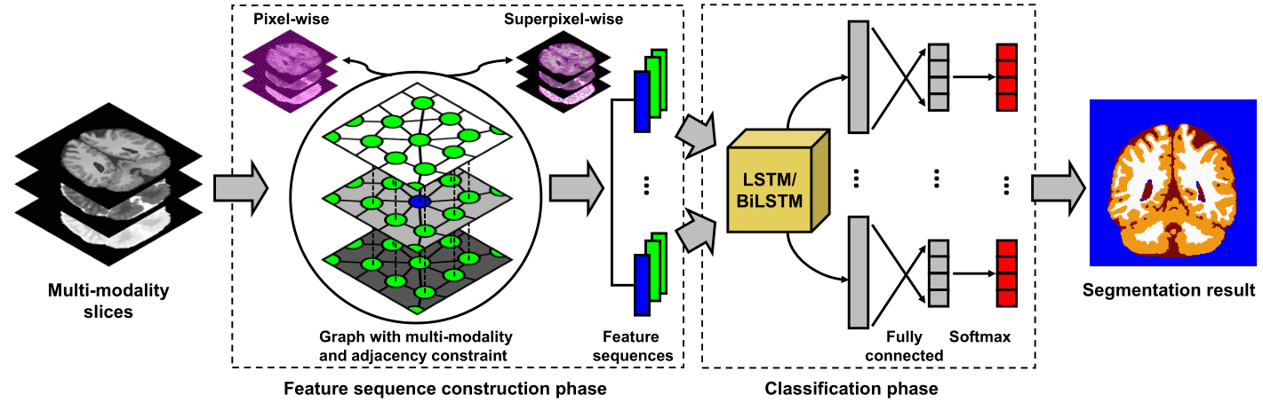
LSTM for Segmentation
Graph and segmentation
For a given image, we consider an input slice as an undirected graph G with adjacency constraint. It is built by connecting a set of graph nodes {vi } Mi=1 via the graph edges {Eij }. Each node v i represents a single pixel or a superpixel region and is connected with several adjacent nodes {vi,j}, j ∈ NG (i). Each edge Eij indicates the spatial relationship between the two corresponding nodes.
Institution of Advanced Control and Intelligent Automation

Slide 12
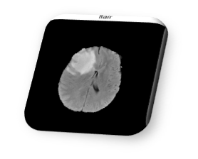
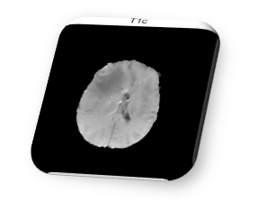
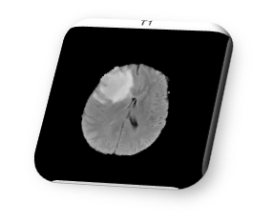
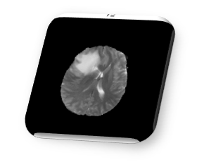
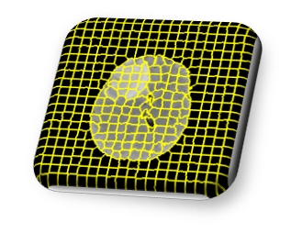
LSTM for Segmentation
Our method
Feature Dimension
The feature of each multi modality slice
Label
Time step
Just the number of neighbors
Softmax
layer
LSTM layer
Fully connected
layer
LSTM layer
Dropout
Institution of Advanced Control and Intelligent Automation

Slide 13
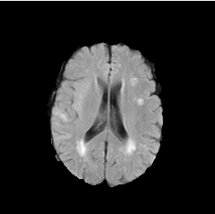


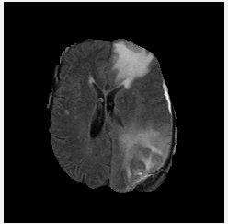
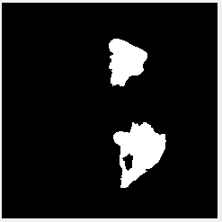
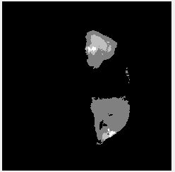
LSTM for Segmentation
Results
Image
Segmentation
Ground Truth
Institution of Advanced Control and Intelligent Automation

Slide 14
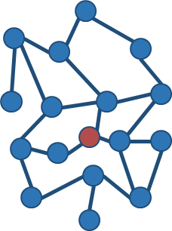
LSTM for Identification
Our method
Feature Dimension
The feature of each feature (like PC, NNC, NNSL, PeC)
Label
Time step
Just the number of neighbors
Softmax
layer
LSTM layer
Fully connected
layer
LSTM layer
Dropout
Institution of Advanced Control and Intelligent Automation

Slide 15
LSTM for Identification of Essential Proteins
Experiment Results (compared with machine learning methods)
Models | Accuracy | Precision | Recall | F-measure | AUC
SVM | 0.7053 | 0.2580 | 0.1777 | 0.2105 | 0.5163
Decision Tree | 0.64047 | 0.1894 | 0.1911 | 0.1902 | 0.4795
Adaboost | 0.6748 | 0.2087 | 0.1688 | 0.1867 | 0.4936
Random Forest | 0.6650 | 0.21 | 0.1866 | 0.1976 | 0.4937
Li et.al | 0.7507 | 0.4186 | 0.2317 | 0.2983 | 0.5681
Our method | 0.71638 | 0.3402 | 0.3933 | 0.3648 | 0.5971
Now | 0.7556 | 0.5058 | 0.5159 | 0.5108 | 0.6751
Institution of Advanced Control and Intelligent Automation

Slide 16
LSTM for Identification of Essential Proteins
Experiment Results (compared with traditional methods)
Models | Accuracy | Precision | Recall | F-measure | AUC
DC | 0.7329 | 0.4052 | 0.3538 | 0.3778 | 0.5997
CC | 0.7137 | 0.3572 | 0.3119 | 0.333 | 0.5725
BC | 0.7125 | 0.3542 | 0.3093 | 0.3302 | 0.5708
EC | 0.7188 | 0.3699 | 0.3230 | 0.3449 | 0.5797
LAC | 0.7565 | 0.4641 | 0.4053 | 0.4327 | 0.6331
Our method | 0.71638 | 0.3402 | 0.3933 | 0.3648 | 0.5971
Now | 0.7556 | 0.5058 | 0.5159 | 0.5108 | 0.6751
Institution of Advanced Control and Intelligent Automation

Slide 17
LSTM for Identification of Essential Proteins
Ablation Experiment
Models | Accuracy | Precision | Recall | F-measure | AUC
Without PC | 0.7409 | 0.4615 | 0.4918 | 0.476 | 0.6556
Without NNSL | 0.7222 | 0.4111 | 0.5086 | 0.4547 | 0.6469
Without PeC | 0.7242 | 0.3833 | 0.5769 | 0.4606 | 0.6694
Without NNC | 0.7311 | 0.4491 | 0.5637 | 0.5 | 0.6736
Now | 0.7556 | 0.5058 | 0.5159 | 0.5108 | 0.6751
Institution of Advanced Control and Intelligent Automation

Slide 18
LSTM for Segmentation
Prepared to do
Choose more effentive features
Write a manuscript?
Connect GCN to our algorithm (Graph Attention Network)
Institution of Advanced Control and Intelligent Automation

Slide 19
Zhanghw@cug.edu.cn
Thank you !
Institution of Advanced Control and Intelligent Automation

